Slide 1

PROG POE PART 2
https://github.com/RC-Pretoria-Campus/prog6221-poe-part-2-Phila-RB/tree/master
How to upgrade your chat Bot with GUI and more
By: Philasande Mkhize
st10486606

Slide 2
New Classes and Methods:
PROGRAM METHODS:
BOTSPEAK
GUI.xaml
GUI.xaml.cs
METHODS:
1. BUTTONCLICK()
2. RUNCONVERSTIONASYNC()
3. ASKASYNC()
4. MSGS()

Slide 3
Program

Slide 4
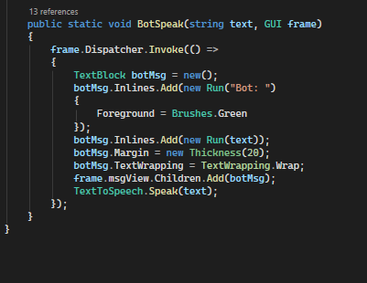
BotSpeak()
This method takes answers generated by the chat bot and displays them on the GUI for the user to see. It also speaks out the text that’s to the speak method

Slide 5
GUI.xaml

Slide 6
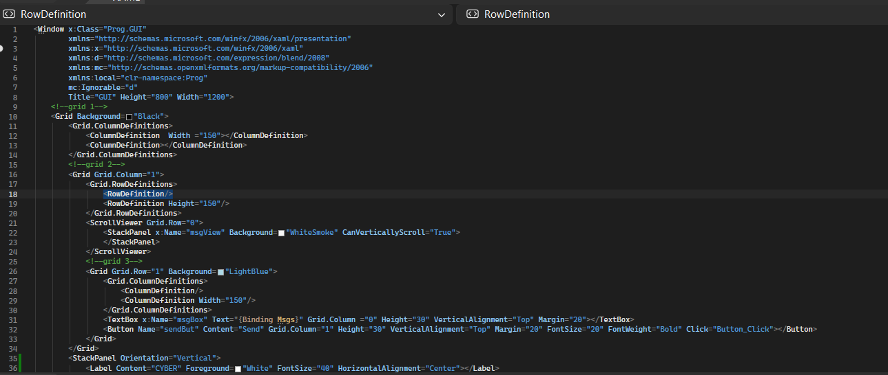
GUI.xaml
The GUI.XAML file is the blueprint of our applications UI. to act as the declarative blueprint for your application's user interface (UI). It allows us to visually layout windows, buttons, text boxes, and graphics without writing any code.

Slide 7
GUI.xaml.cs

Slide 8
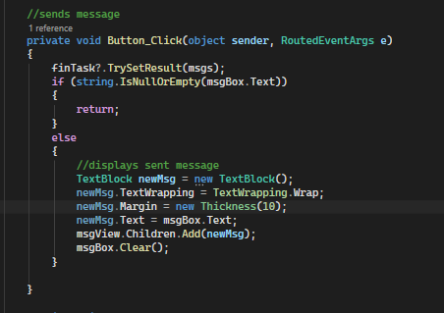
ButtonClick()
This method comes from interaction with the GUI button. When pressed the message in the message box will be sent and displayed on the GUI with the following elements created for it and styles applied

Slide 9
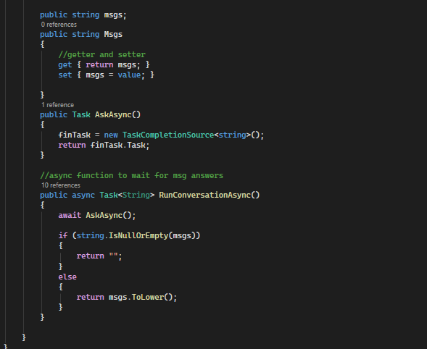
RunConversationAsync() and more
RunConversationAsync is an asynchronous function which serves to keep the program running without blocking code. It along with AskAsync will wait for the user to give input without stopping the rest of the code from running. Msgs has a getter and a setter to hold and return sent message

